Slide 1
CONNECT-4 GAME DATASET
Danny Huang
Behzad Pouyanfar

Slide 2
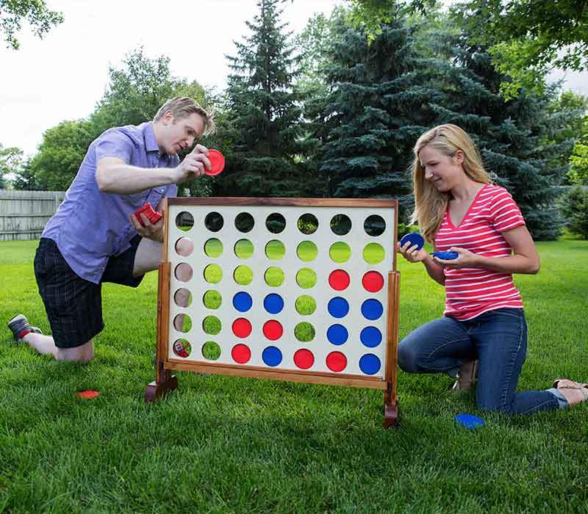
Connect-4 Game Dataset is consist of 43 columns. The last column represents the winner with values -1, 1 and 0 for ties. For the sake of binary classification, ties are disregarded. After cleanup, we got 370k rows. Each row represents the outcome of a game and each element in 42 columns represent to player’s piece: 1 and -1, 0 marks on an empty cell. Basically columns show the position of the grid from left to right, top to bottom.
There are 90% data points for training and 10% for the test set. About 50% player A wins and 50% player B.
This dataset was originally gathered to see if an Artificial Neural Network could be trained. The LearningAI uses the model to infer the best decision given the state of the C4 grid and a list of possible moves.
Notes:
3.a

Slide 3
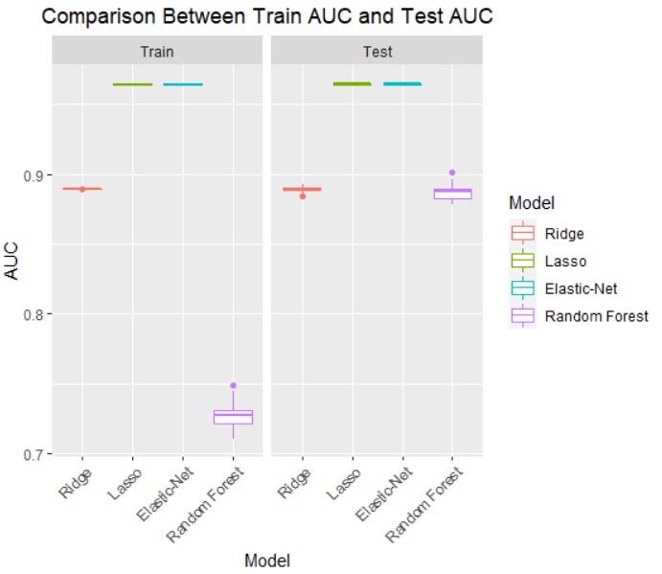
Boxplots of 50 AUCs for Test and Train
 | Train AUC (Average) | Test AUC (Average)
Ridge | 0.8890 | 0.8891
Lasso | 0.9642 | 0.9642
Elastic Net | 0.9641 | 0.9641
Random Forest | 0.7272 | 0.8867
Notes:
3.b

Slide 4
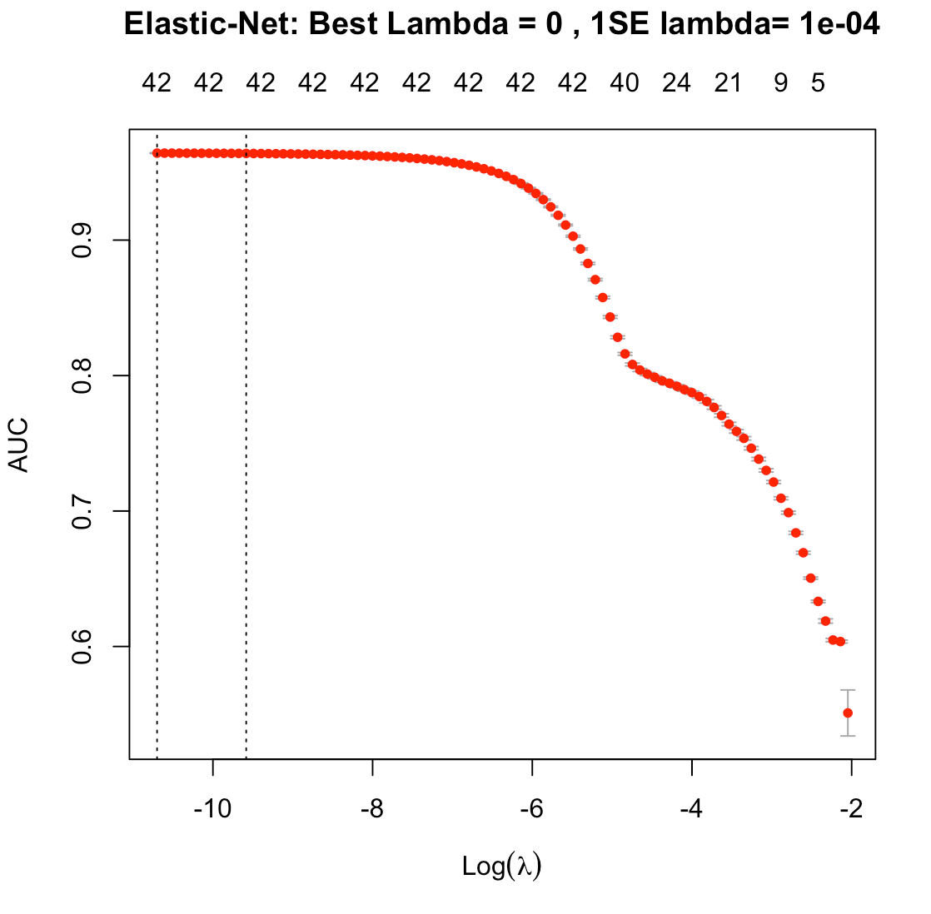
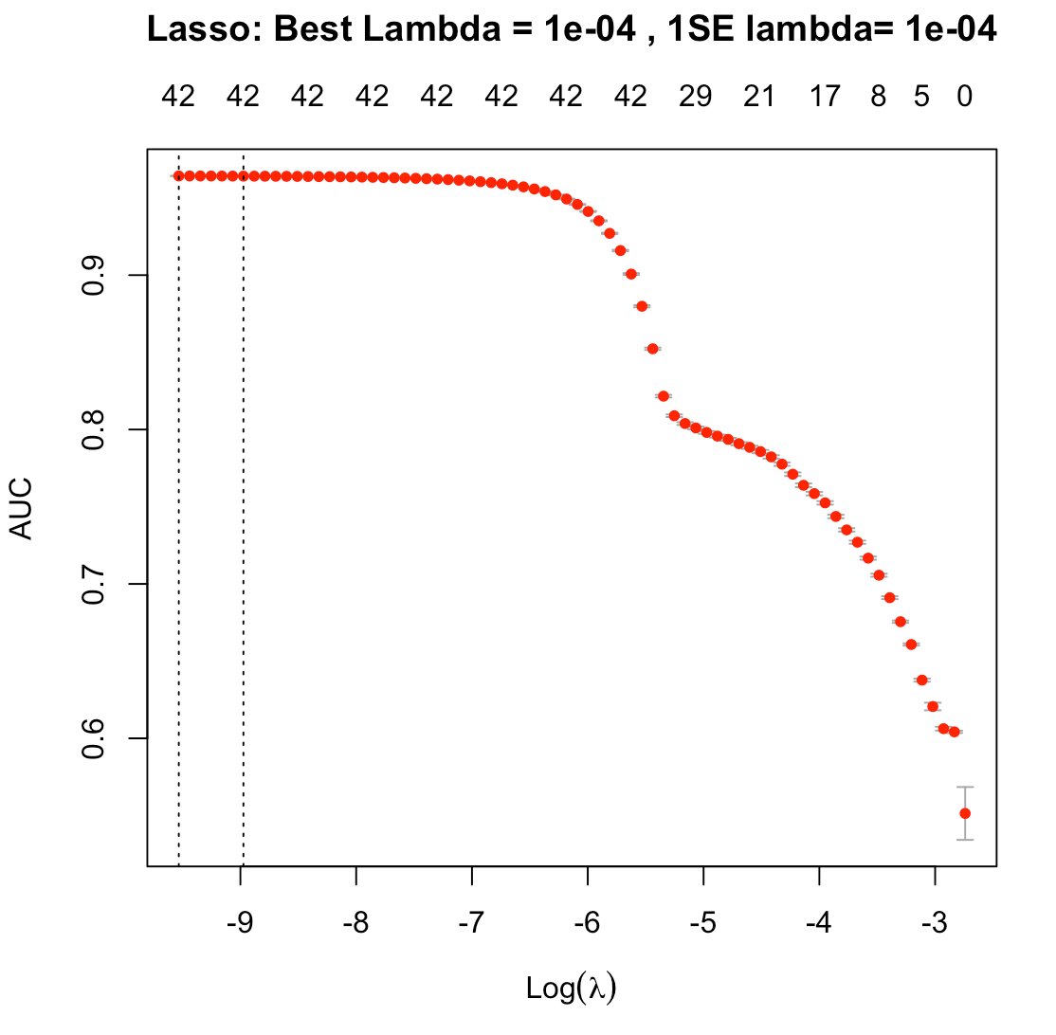
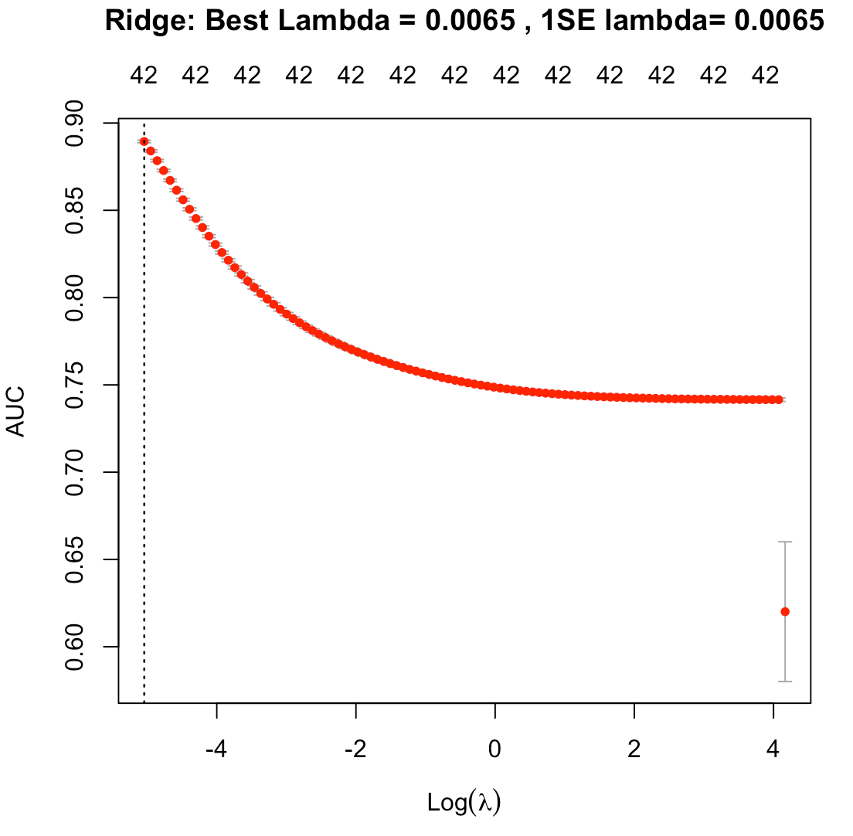
Cross-Validation Curves
(Larger Lambda vs Smaller Lambda)
Notes:
3.c

Slide 5
Results of 50 Simulations: Time vs Accuracy
(90% Confidence Interval for Test AUC)
 | Test AUC Lower Bound For 90% confidence interval | Test AUC Upper Bound For 90% confidence interval | CV Time (Average) | Single Fitting Time (Average)
Ridge | 0.886 | 0.892 | 7.4 minutes | 2.8 seconds
Lasso | 0.963 | 0.965 | 25.9 minutes | 35.3 seconds
Elastic-Net | 0.963 | 0.965 | 26.4 minutes | 31.8 seconds
Random Forest | 0.878 | 0.895 | NA | 3.2 minutes
Notes:
3.d.1

Slide 6
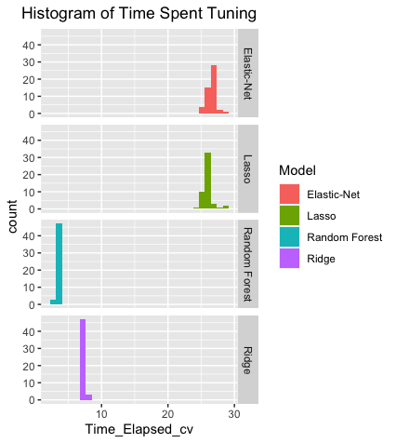
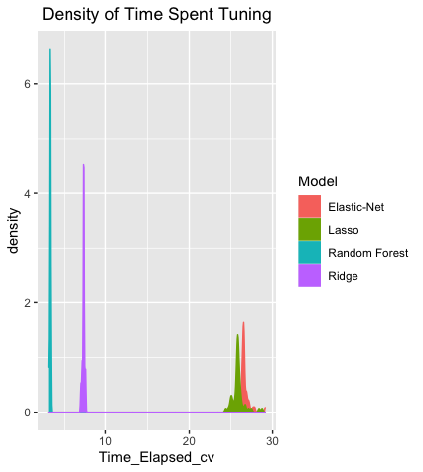
Comparison of Time Spent at Parameters Tuning

Slide 7
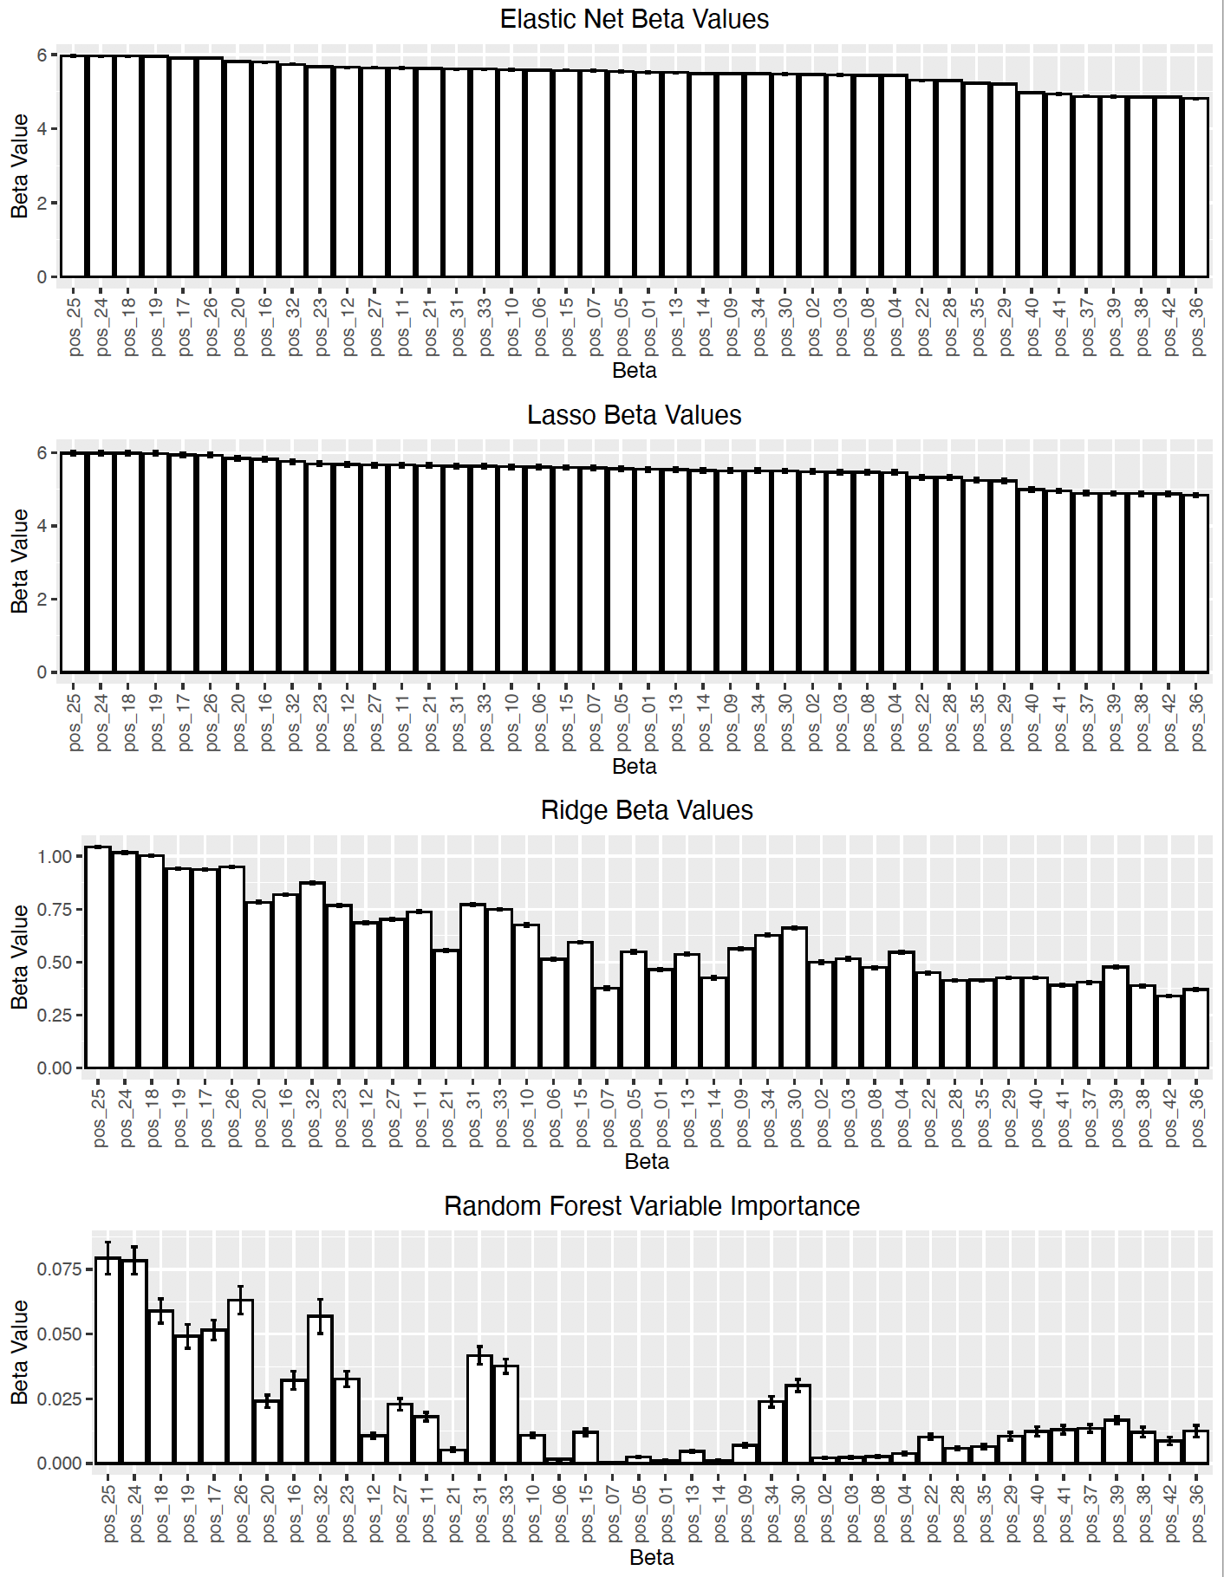
Estimated Coefficients
Are all variables REALLY good indicators of Winning?
Yes, due to the nature of variables being positions at the board game.
Random Forest with
mtry= 6
ntree = 25
Notes:
3.d.2

Slide 8
To Conclude:
Our results are data-dependent.
1000 data points vs 100,000 data points
Linear Models versus Random Forest
Time
Accuracy
What if we have a different type of dataset where most variables are not relevant?

